Slide 1
PORTFOLIO INTELLIGENCE SUITE
01 / 15
A SIX-MONTH PORTFOLIO CASE STUDY
I own 48 stocks. But is the portfolio actually healthy?
I built a dashboard to understand performance, risk and diversification — not just profit.
29.9%
−5.6%
vs
6-MONTH BASKET GROWTH
NIFTY 50
The interesting part is what happened between the start and finish.
Start the story →
Power BI • DAX • Power Query • Financial Analytics

Slide 2
PORTFOLIO INTELLIGENCE SUITE
02 / 15
CONTEXT FIRST
48 holdings, one benchmark and six months of daily market behaviour.
48
6M
NIFTY
STOCKS
PERIOD
BENCHMARK
large + mid + small
27 Jan–24 Jul 2026
both indexed to 100
PURPOSE
To answer three practical investor questions:
1 Did the portfolio beat the market?
2 What risk came with that growth?
3 Is capital diversified or concentrated?
Method: today’s 48-stock basket was valued at historical daily prices. This is a fixed-basket comparison, not a reconstruction of actual purchase dates.
Swipe →
Power BI • DAX • Power Query • Financial Analytics

Slide 3
PORTFOLIO INTELLIGENCE SUITE
03 / 15
THE ANALYTICAL JOURNEY
The dashboard follows the same questions a viewer naturally asks.
1
What happened?
Actual portfolio value plus historical basket growth versus NIFTY.
2
How difficult was the journey?
Volatility, beta, correlation and drawdown.
3
Where is the money?
Market cap, sector, industry and holding allocation.
4
What deserves attention?
Winners, weak positions and risk–return quadrants.
Swipe →
Power BI • DAX • Power Query • Financial Analytics

Slide 4
PORTFOLIO INTELLIGENCE SUITE
04 / 15
FOUR TERMS — NO FINANCE DEGREE REQUIRED
These metrics describe movement, similarity and downside.
VOLATILITY
How sharply returns moved up and down.
22.1% annualised
BETA
How strongly the portfolio reacted to market moves.
1.04 overall
CORRELATION
How closely it moved in the same direction as NIFTY.
0.80
DRAWDOWN
The largest fall from a previous portfolio peak.
−9.4%
Swipe →
Power BI • DAX • Power Query • Financial Analytics

Slide 5
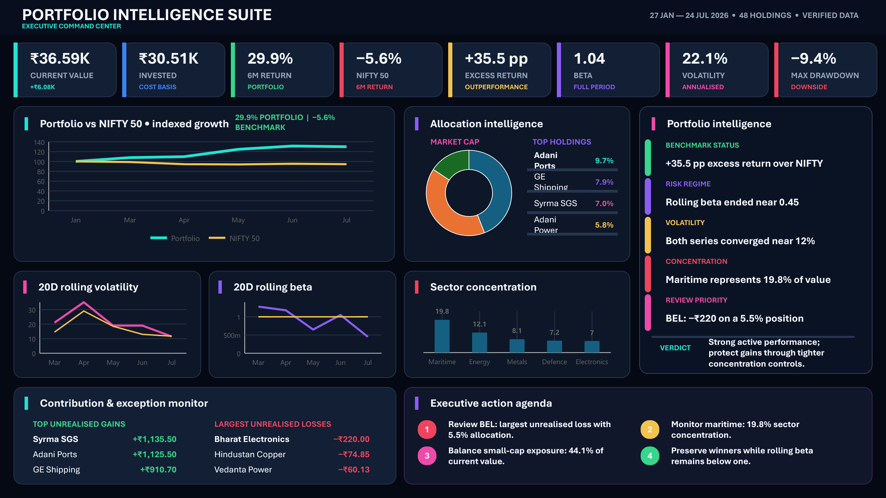
PORTFOLIO INTELLIGENCE SUITE
05 / 15
THE FINISHED DASHBOARD
One page combines the answer, the evidence and the action.
WHY THIS PAGE EXISTS
A recruiter sees the conclusion quickly. A finance viewer can inspect the measures. A layperson can follow the insight panel.
Swipe →
Power BI • DAX • Power Query • Financial Analytics

Slide 6
PORTFOLIO INTELLIGENCE SUITE
06 / 15
START WITH THE OUTCOME
₹30.51K of actual purchase cost is now worth ₹36.59K.
₹30.51K
₹36.59K
INVESTED CAPITAL
CURRENT VALUE
cost basis
market value
₹6.08K
29.9%
UNREALISED GAIN
6-MONTH HISTORICAL GROWTH
19.9% on invested capital
fixed basket: 27 Jan–24 Jul
TWO DIFFERENT STARTING POINTS
ACTUAL GAIN • ₹30.51K is the purchase cost, independent of the chart timeline. Current value ₹36.59K = +19.9%.
HISTORICAL GROWTH • The same 48-stock basket was worth ₹28.16K on 27 Jan and ₹36.59K on 24 Jul = +29.9%.
The historical figure does not represent your personal purchase-date return.
Swipe →
Power BI • DAX • Power Query • Financial Analytics

Slide 7
PORTFOLIO INTELLIGENCE SUITE
07 / 15
THE SIMPLEST BENCHMARK STORY
Indexed to the same starting value of 100, the basket ended near 130 and NIFTY near 94.
PLAIN ENGLISH
The fixed basket grew 29.9% while NIFTY fell 5.6%: a 35.5 percentage-point gap. Indexing makes different rupee sizes comparable.
Swipe →
Power BI • DAX • Power Query • Financial Analytics

Slide 8
PORTFOLIO INTELLIGENCE SUITE
08 / 15
GROWTH IS ONLY HALF THE STORY
The basket was initially bumpier than NIFTY, but the volatility gap narrowed.
WHAT CHANGED?
Portfolio volatility peaked near 35% around April. By late July, both portfolio and NIFTY were close to 12%.
Swipe →
Power BI • DAX • Power Query • Financial Analytics

Slide 9
PORTFOLIO INTELLIGENCE SUITE
09 / 15
RISK CHANGED THROUGH TIME
Six-month beta was 1.04, but 20-day rolling beta ended near 0.45.
BETA
CORRELATION • 0.80
Sensitivity to market movement declined sharply by the end.
Daily returns generally moved with NIFTY, but not identically.
Swipe →
Power BI • DAX • Power Query • Financial Analytics

Slide 10
PORTFOLIO INTELLIGENCE SUITE
10 / 15
IS THE PORTFOLIO DIVERSIFIED?
Small caps lead by value, while large caps provide a substantial counterweight.
44.1%
SMALL CAP
40.2%
LARGE CAP
INTERPRETATION
48 stocks sounds diversified—but value weighting reveals where the actual exposure sits.
Swipe →
Power BI • DAX • Power Query • Financial Analytics

Slide 11
PORTFOLIO INTELLIGENCE SUITE
11 / 15
WHERE DID VALUE CONCENTRATE AND GROW?
Maritime is both the largest sector and the largest gain contributor.
LARGEST SECTOR
INDUSTRY SIGNAL
Maritime • 19.8% of value
Electronics manufacturing
Adani Ports • GE Shipping • SCI
Gain contribution: +₹2.16K
Syrma SGS contributed +₹1.14K
Swipe →
Power BI • DAX • Power Query • Financial Analytics

Slide 12
PORTFOLIO INTELLIGENCE SUITE
12 / 15
WHICH HOLDINGS DROVE THE RESULT?
Strong contributors and review candidates become visible immediately.
TOP UNREALISED GAINS
LARGEST UNREALISED LOSSES
Syrma SGS
+₹1,135.50
Bharat Electronics
−₹220.00
Adani Ports
+₹1,125.50
Hindustan Copper
−₹74.85
GE Shipping
+₹910.70
Vedanta Power
−₹60.13
POSITION SIZE MATTERS
Adani Ports is the largest holding at 9.7%. BEL is the largest unrealised loss and still represents 5.5% of value.
Swipe →
Power BI • DAX • Power Query • Financial Analytics

Slide 13
PORTFOLIO INTELLIGENCE SUITE
13 / 15
REWARD VERSUS UNCERTAINTY
The risk–return quadrant turns a technical scatter plot into a review queue.
LOWER RISK
HIGHER RETURN
HIGHER RISK
HIGHER RETURN
Adani Power
Return 58.9% • Vol 39.0%
Syrma SGS
Return 96.1% • Vol 45.7%
LOWER RISK
LOWER RETURN
BORDERLINE REVIEW
CANDIDATE
Adani Ports
Return 29.7% • Vol 31.6%
Shipping Corporation
Return 30.4% • Vol 53.4%
METHOD • Return = each stock’s six-month price change • Volatility = annualised variation in daily returns
Quadrant reference lines: average return 30.4% • average volatility 44.5%
Swipe →
Power BI • DAX • Power Query • Financial Analytics

Slide 14
PORTFOLIO INTELLIGENCE SUITE
14 / 15
THE WHOLE STORY ON ONE PAGE
Strong performance, moderating risk and identifiable concentration.
PERFORMANCE
Fixed basket +29.9% vs NIFTY −5.6%; actual unrealised gain is 19.9%.
RISK
Volatility converged near 12%; 20-day rolling beta ended near 0.45.
MARKET CAP
Small caps lead at 44.1%; large caps provide 40.2%.
SECTOR
Maritime is largest at 19.8% and added +₹2.16K in unrealised gain.
HOLDINGS
Adani Ports is largest; Syrma is top gainer; BEL needs review.
Swipe →
Power BI • DAX • Power Query • Financial Analytics

Slide 15
PORTFOLIO INTELLIGENCE SUITE
15 / 15
WHY THIS PROJECT MATTERS
It translates financial calculations into a story that different audiences can use.
1
For a layperson
Understand what happened without needing a finance background.
2
For a recruiter
See business framing, data storytelling and decision-focused design.
3
For a finance viewer
Inspect beta, correlation, drawdown, volatility and allocation logic.
BUILT WITH
Python • Power BI • DAX • Power Query • Excel
Portfolio Intelligence Suite
Vikramaditya Rathore | vikramadityaanalytics.com
End • Thank you
Power BI • DAX • Power Query • Financial Analytics

